Slide 1
Right-to-Work (For Less)
Nicholas J. Enoch Western States Council
Lubin & Enoch, PC SMART Convention
www.lubinandenoch.com October 6-7, 2017
Phoenix−Denver − El Paso − Des Moines Reno, Nevada

Slide 2
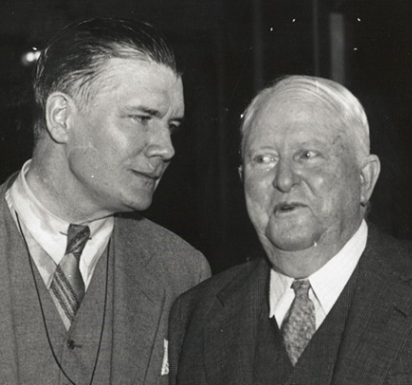
The Racist Origins of Right to Work
Texan Vance Muse of the Christian American Association (“the Association”) led the campaign to outlaw contracts that required employees to belong to unions.
Muse had also campaigned against women’s suffrage, the constitutional amendment prohibiting child labor, the eight-hour day law, the New Deal, and the re-election of Roosevelt.
To push many of his lobbying efforts, Muse utilized anti-semitic, racist, anti-communist and anti-union arguments and fear.
Vance Muse (left) led the fight for right-to-work

Slide 3

The Association began attacking the CIO in the early 1940s, claiming their organizers were inflaming the “contented but gullible” African-Americans as the first step to Sovietize the nation.
Organized labor was rapidly growing and union membership, which was 10% in the 1930s, exploded by 225% in the 40s. The AFL and CIO posed an economic and social threat as they were gaining bargaining power and improving wages and working conditions for working people. They also posed a political threat as they opposed Jim Crow and demanded an end to segregation.
The Association’s efforts to help enact anti-union laws were funded by Southern planters and industrialists.

Slide 4

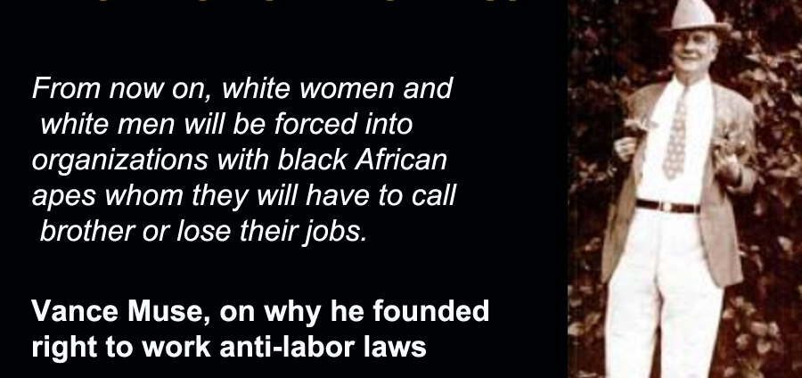
Muse’s first successful anti-union legislation was the anti-strike law which made strikers criminally liable for violence on the picket line.
Pleased with the anti-strike law, in 1944, the Arkansas Farm Bureau Federation sponsored the campaign to secure a right-to-work amendment for the Arkansas constitution.
Both laws were designed to weaken unions.
Union growth was equated with race-mixing and communism. The legislation was promoted as essential to “maintain the color line in labor relations.”

Slide 5
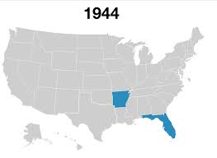
Arkansas, Florida and California were the first states where voters could cast ballots for right-to-work laws. Few African Americans could cast free ballots and election fraud was rampant. The law passed in AR and FL, but not CA.
By 1947, 14 states had passed right-to-work laws. That year, Congress passed Section 14(b) of the Taft-Hartley Act, enshrining the right of states to pass laws that allow workers to receive union benefits without joining a union.

Slide 6

Cecil B. DeMille’s Showdown

Slide 7
Indiana: The Right to Work for Less State

Slide 8
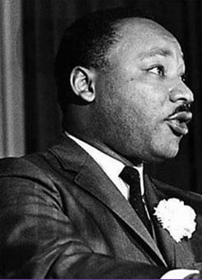
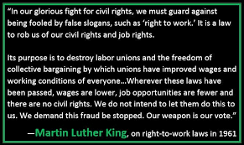

Slide 9
29 U.S.C. § 164(b) (Taft Hartley § 14b)
“Nothing in this subchapter shall be construed as authorizing the execution or application of agreements requiring membership in a labor organization as a condition of employment in any State or Territory in which such execution or application is prohibited by State or Territorial law.”

Slide 10
Arizona Constitution Art XXV (1946)
“No person shall be denied the opportunity to obtain or retain employment because of non-membership in a labor organization, nor shall the State or any subdivision thereof, or any corporation, individual or association of any kind enter into any agreement, written or oral, which excludes any person from employment or continuation because of non-membership in a labor organization.”

Slide 11
A.R.S. 23-1302 (enacted 1955)
“No person shall be denied the opportunity to obtain or retain employment because of nonmembership in a labor organization, nor shall the state or any subdivision thereof, or any corporation, individual, or association of any kind enter into an agreement, written or oral, which excludes a person from employment or continuation of employment because of nonmembership in a labor organization.”

Slide 12
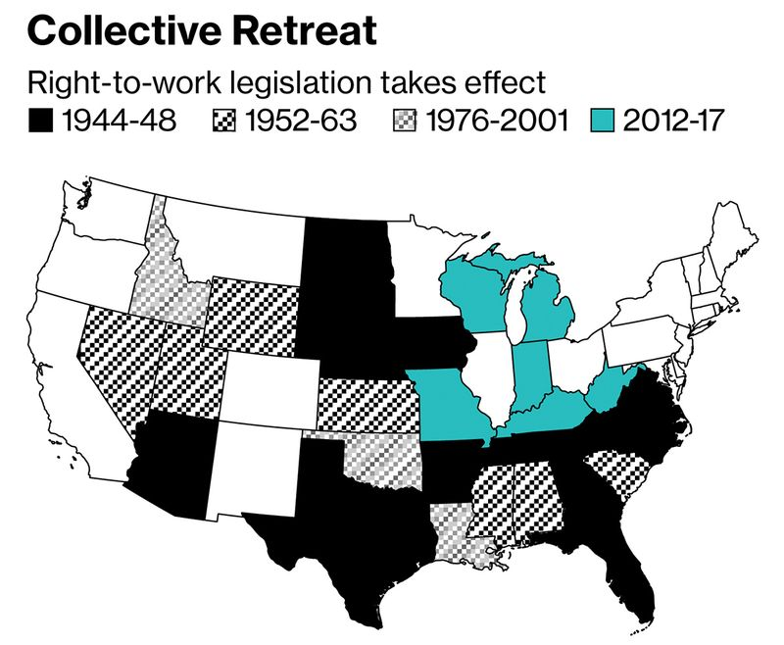
Today: 28 States have Right to Work Laws

Slide 13
What are “Right-To-Work” laws?
The laws vary from state-to-state, but their essence is that they allow members of a represented bargaining unit to refuse to contribute financially to the union that is nonetheless obliged by federal law
To represent them in their terms and conditions of employment
To bargain on their behalf
To advocate in their interests fairly , in good faith, and without discrimination including pursuing grievances and even (costly) arbitrations for them, as they would for dues-paying members.

Slide 14
“Right to Work” is Not…
The right to be hired by a unionized employer even if you don’t already belong to the union: That right was guaranteed under the Taft-Hartley Act when it outlawed “closed” shops;
The right to refuse to join a union based on sincerely held religious beliefs: That is being a “religious objector,” and if a person falls into this category, s/he can substitute some forms of charitable giving for union dues;
The right to refuse to pay for political activities of a union: That is “fee payor” status and allows a non-member to pay only for the representational (non-political-advocacy) activities of the union. (SPEEA doesn’t include charges for political activity in its dues.)
It is also not the “right to work”

Slide 15
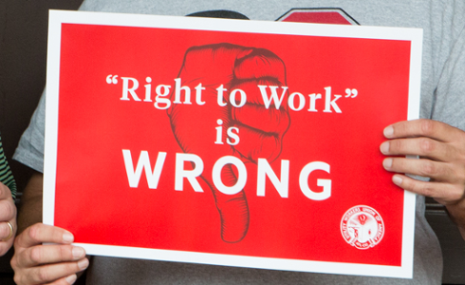
“Right to Work” is the right to be a union free rider- to have other people pay to represent you!

Slide 16
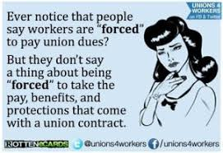
Supreme Court Justice Antonin Scalia wrote:
“What is distinctive, however, about the ‘free riders’ [in unions] . . . is that . . . the law requires the union to carry [them]—indeed, requires the union to go out of its way to benefit [them], even at the expense of its other interests. . . . [T]he free ridership . . . would be not incidental but calculated, not imposed by circumstances but mandated by government decree.”

Slide 17
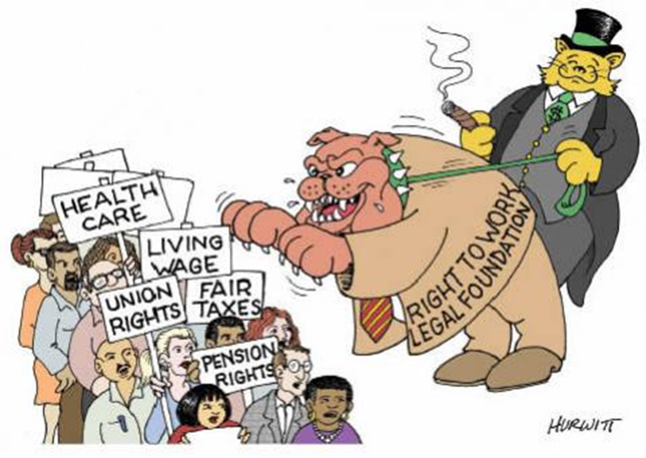
Practical/Economic Impact of RTWFL
Supporters of the Right to Work For Less (RTWFL) assert a wide array of economic advantages to states that pass it. Opponents disagree. Some of our supporting data:
  On average, workers in states with right-to-work laws made $6,109 a year (12.1%) less annually than workers in other states in 2014.
  The rate of employer-sponsored pensions was 4.8 percentage points lower in RTWFL states in 2011.
(continued)

Slide 18
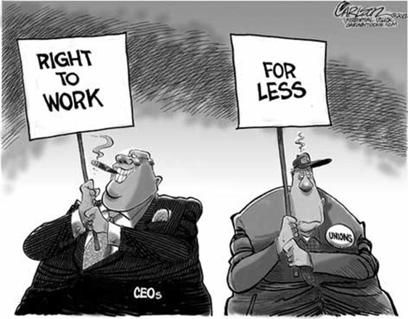
  The number of businesses and self-employed are greater on average in right-to-work –for –less states, but employment, wages, and per-capita personal income were found in 2009 all to be lower on average in right-to-work states.
  In 2014, the rate of workplace deaths was 49% higher in states with right to work-for-less laws.
  In 2013, only 47% of private-sector employers in RTWFL states offered insurance coverage to their employees compared to 52.2% elsewhere, and workers in RTWFL states paid a larger percentage of their premium cost.

Slide 19
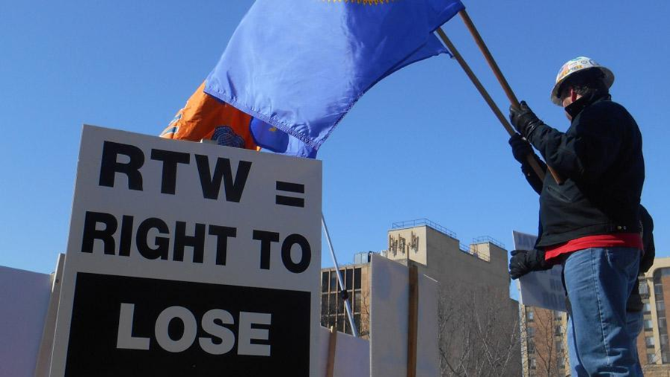
The Right to Shirk: Indiana v. New Hampshire
NEW HAMPSHIRE
(No right to work laws)
INDIANA
(Right to work state)
Poverty level 8.2% 14.5%
Per capita Income $55,905 $41,940
Why are state and federal lawmakers pushing right-to-work legislation?
The answer is simple: Republican lawmakers seek to weaken unions financially and politically, making it harder for working people to bargain for higher wages and stronger workplace protections.

Slide 20
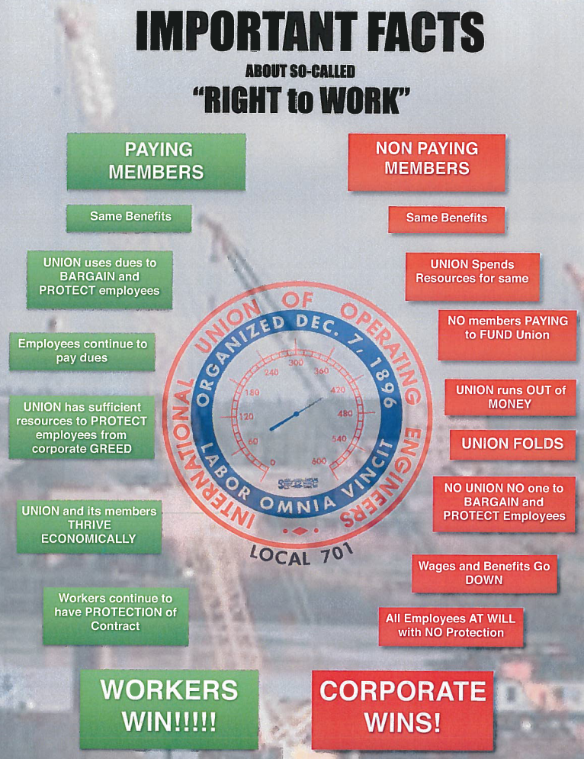

Slide 21
Coping with RTWFL: Union Strategies
RTWFL need not be the end of a union’s world: There are successful unions in RTWFL states. It takes work and creativity to succeed. Some ideas:
  Remember that every day, in every location, is an organizing opportunity (and risk). The union has to commit time and money to remaining in (as close as it can) constant contact with the non-members to see what they want and need in the workplace. The best organizing tool in a RTWFL environment is attentive service to the non-members.
  Think about Carrots and Sticks!

Slide 22
“Members-Only” Programs and Benefits
The Carrots …
Develop a robust set of “members-only” programs and benefits. These can’t establish terms and conditions of employment. (Those are covered by the “duty of fair representation.”) But they can include:
  Group insurance products like disability or life insurance;
  Assistance for (non-negotiated) benefits like unemployment or workers’ compensation or statutory appeals of benefit claim denials;
  Child care support
  Educational assistance or membership-only training;
  Music, art or knitting classes . . . Hiking clubs . . .Let your imaginations run wild as to what any collection of like (and unlike) minded people might want to do together

Slide 23
Employ whatever Sticks are in your Arsenal
There is no right to be a secret freeloader: You can publish the names of non-members on social media; on union bulletin boards in the workplace; and on your website. These people are scabs, and can be called that.
Remind non-members that they have no say in the collective bargaining process. They have no right to come to meetings; to be surveyed about their opinions; or to vote on representatives or an agreement.

Slide 24
(Future) Contract Language
Unions that have the opportunity to orient new employees to the benefits of membership have a surprisingly high success rate even in RTWFL states and federal employment. A typical clause might read:
“Union Participation in New Employee Orientation : During the course of any employment orientation program for new bargaining unit employees, or in the event a current bargaining unit employee is reassigned to the bargaining unit, the Union shall be given ample opportunity, but in any event no less than one hour, to address such new employees, provided that this provision does not preclude the Employer from addressing employees concerning the same subject. The current collective bargaining agreement and any documents governing any fringe benefit programs referenced in the agreement shall be provided to such new or current employees as part of their orientation.”

Slide 25
Canada’s Push to End RTW
“Canadian officials are using negotiations over NAFTA to press the U.S. to pass a federal law banning states from having right-to-work laws.” – The Washington Examiner, Sep. 11, 2017
“Canada asserted that lower standards in the United States and Mexico give those countries an unfair advantage.” – LA Times, Sep. 10, 2017

Slide 26
Sources
“The Racist Origins of Right to Work,” August 3, 2017, Labor Notes, available at http://www.labornotes.org/blogs/2017/08/racist-who-pioneered-right-work-laws
“The Racist Roots of ‘right to work’ laws,” December 13, 2012, Facing South, available at https://www.facingsouth.org/2012/12/the-racist-roots-of-right-to-work-laws
  Bureau of Labor Statistics, Quarterly Census of Employment and Wages , 2014
  “The compensation penalty of “right-to-work” laws,” Economic Policy Institute, 2/11
  “The Effect of Endogenous Right-to-Work Laws on Business and Economic Conditions in the United States: A Multivariate Approach,” Review of Law and Economics, Vol. 5, No. 1, pp. 595-614, 2009
  ²Bureau of Labor Statistics, National Census of Fatal Occupational Injuries in 2014.
  ³Corporation for Enterprise Development, , Employee Share of the Premium, 2014.
  “Unions are losing their decades-long ‘right to work’ fight,” February 16, 2017, Bloomberg Businessweek, available at https://www.bloomberg.com/news/articles/2017-02-16/unions-are-losing-their-decades-long-right-to-work-fight

